Slide 1
Getting places
Taxi rides in
New York City

Slide 2


K-means clustering identified 2 groups
Shorter Trips
(inner city)
Longer Trips
(airport)

Slide 3
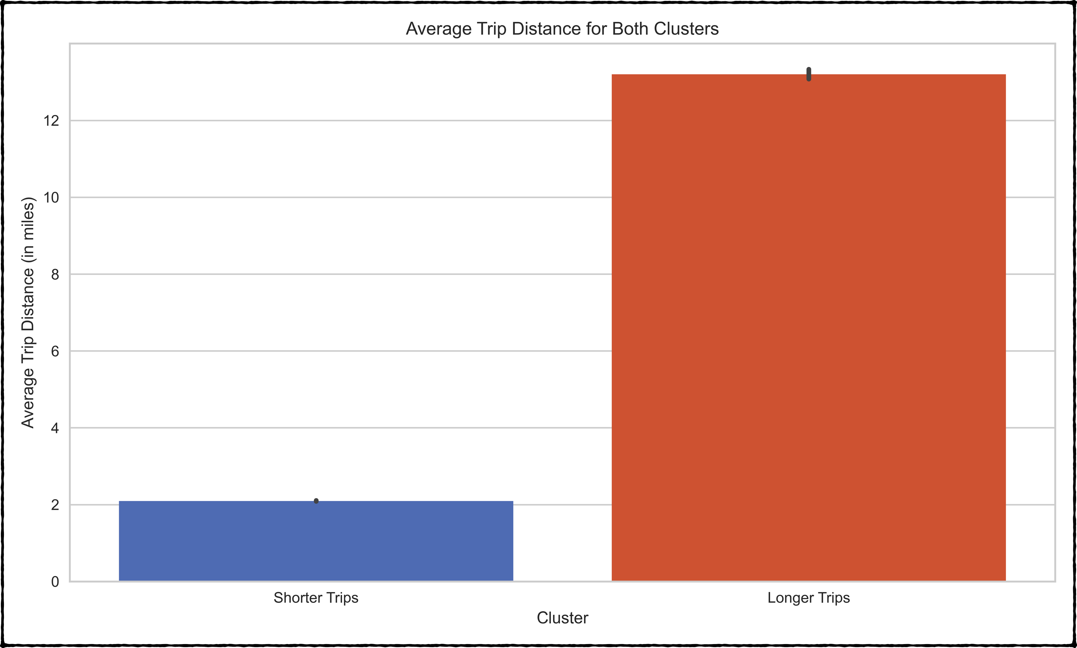

Slide 4
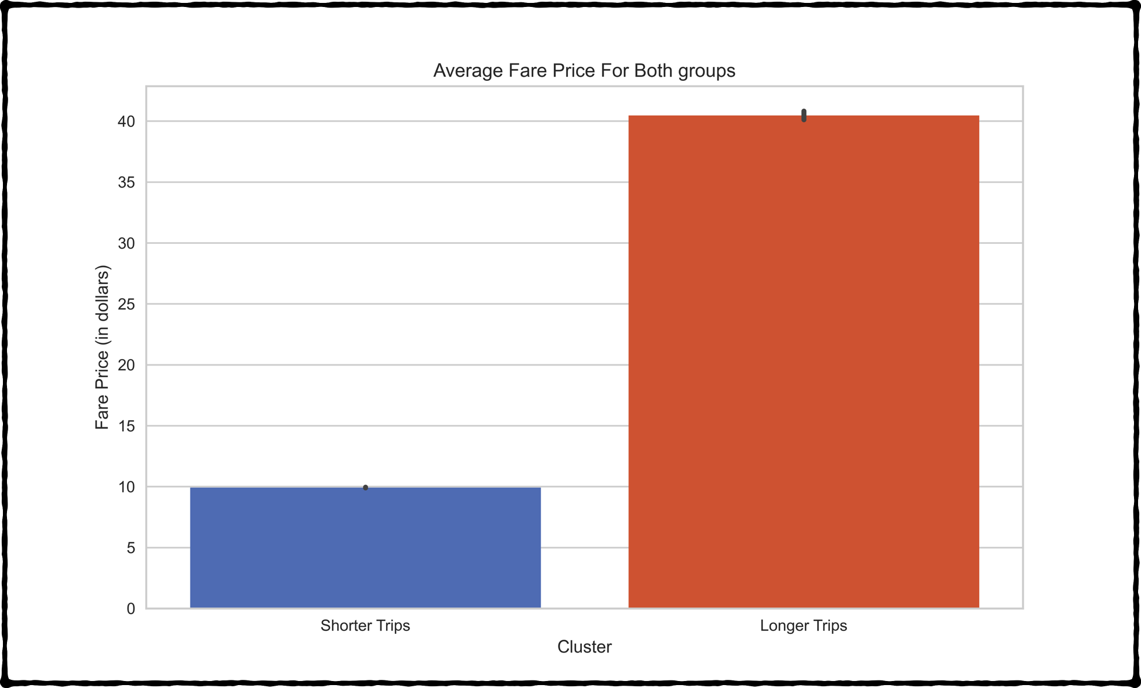
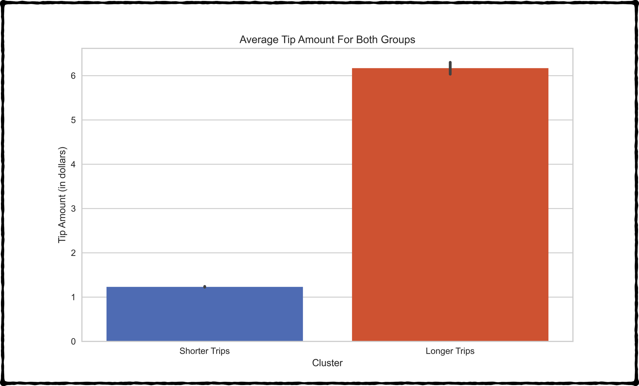

Slide 5
Are there any geographical patterns?
Longer Trips
Shorter Trips

Slide 7
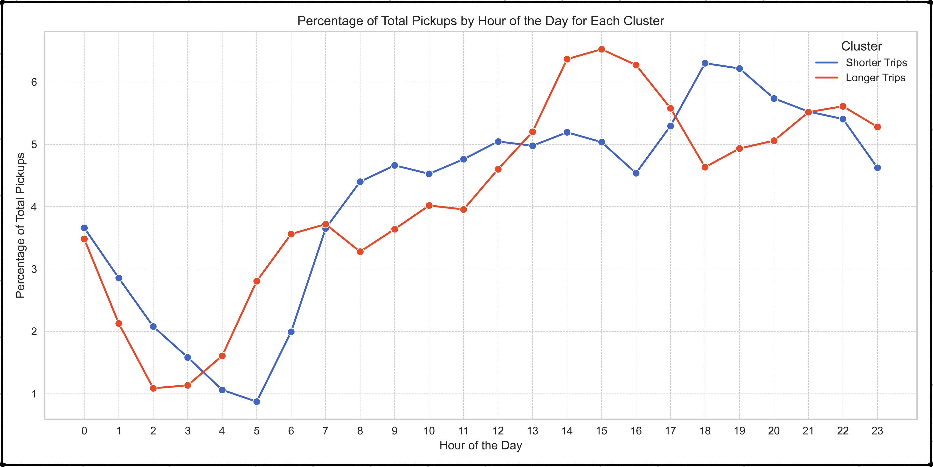

Slide 8
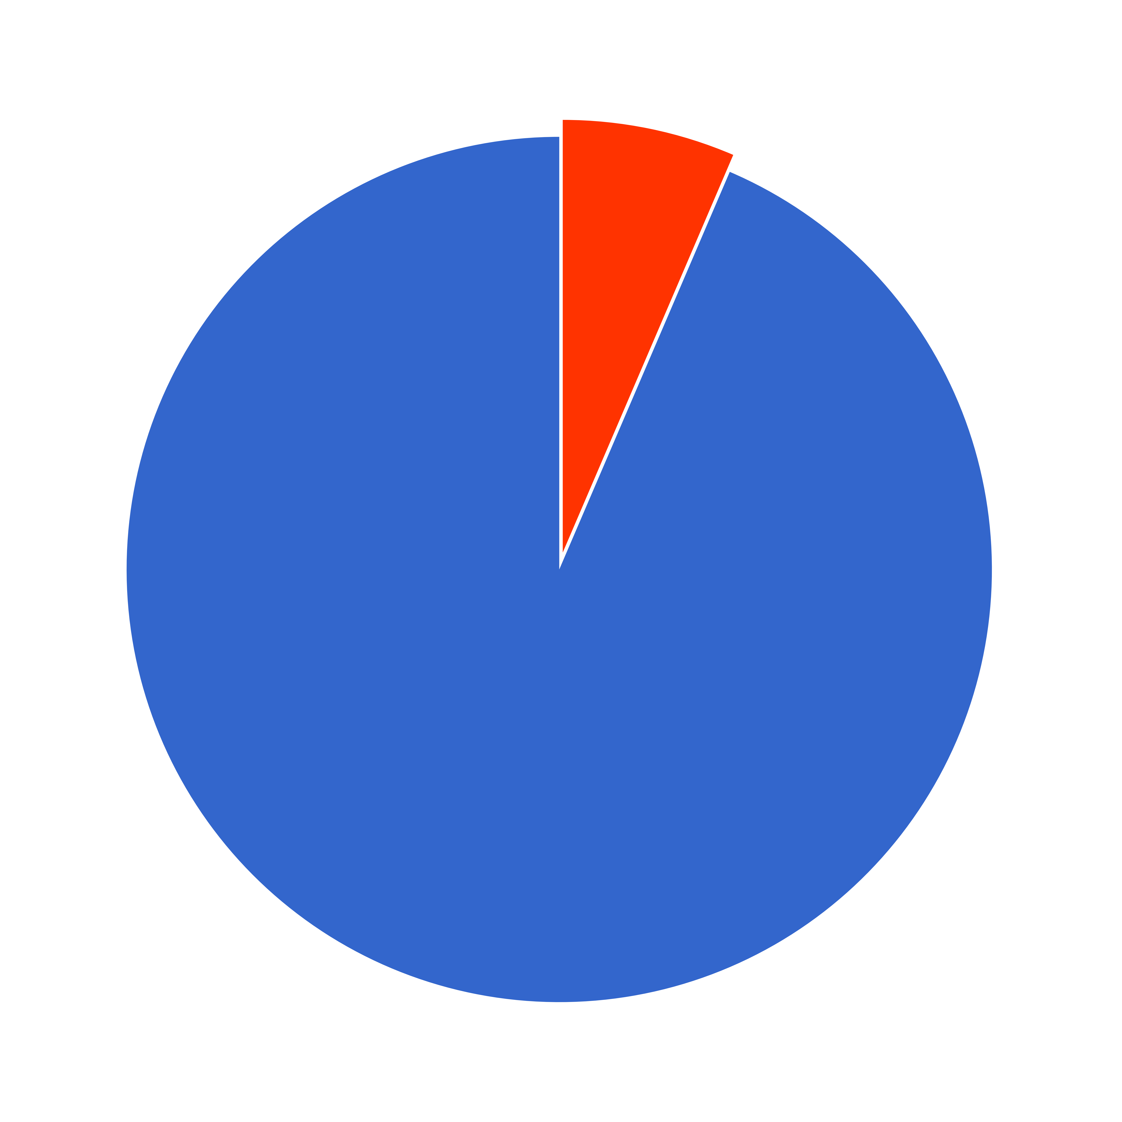
Distribution of datapoints
for both cluster
Longer Trips
6.4%
Shorter Trips
93.6%

Slide 9
Conclusions
Longer trips, higher tips
Many go to or from the airport at around 3 pm Many take short trips around 6 pm (from work most likely)
The majority of trips are short, begin and end on Manhattan

Slide 10
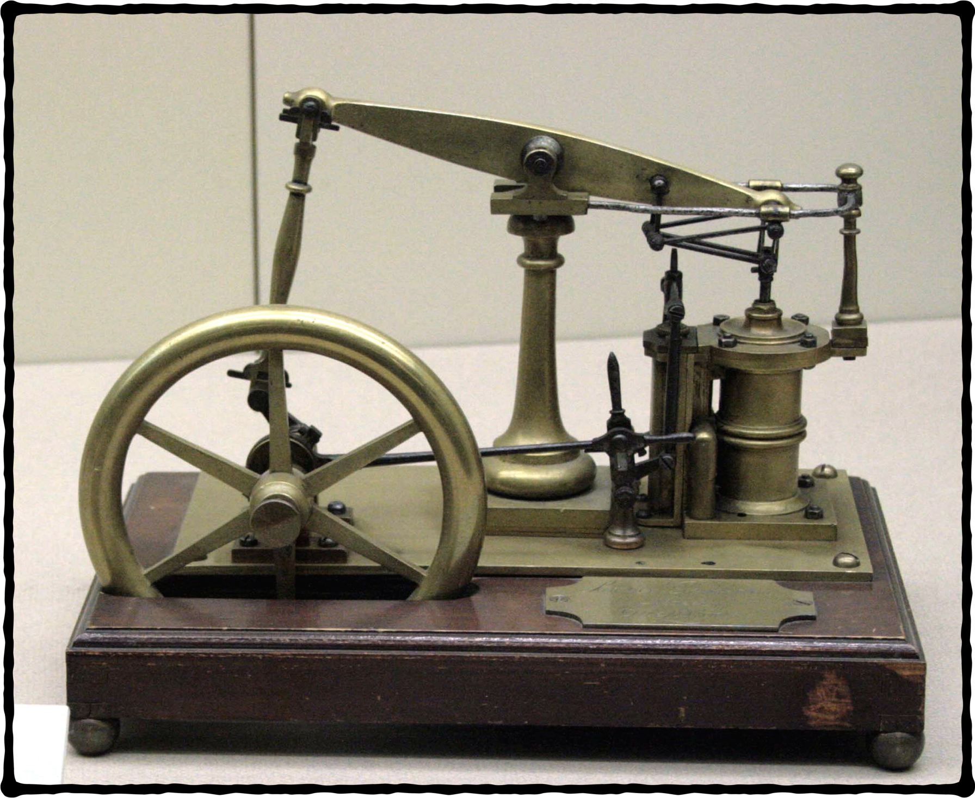
Learnings and improvements
Learned the workflow quickly
More experimentation with the clustering could have led to other insights
Airport trips can be examined closer (to airport vs from airport for example)

